Slide 1
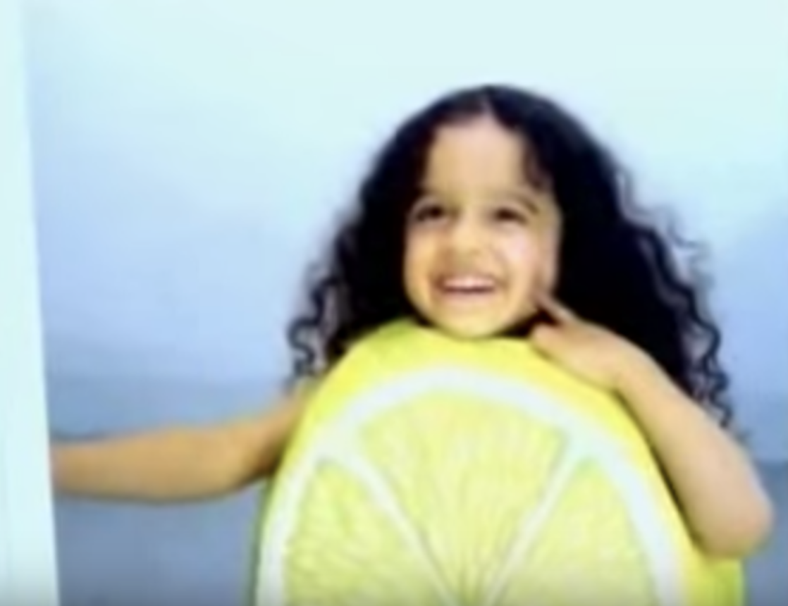
"Miss Nimbupani" was the class' heartthrob in which beverage commercial?
Notes:
Rasna Juice

Slide 2
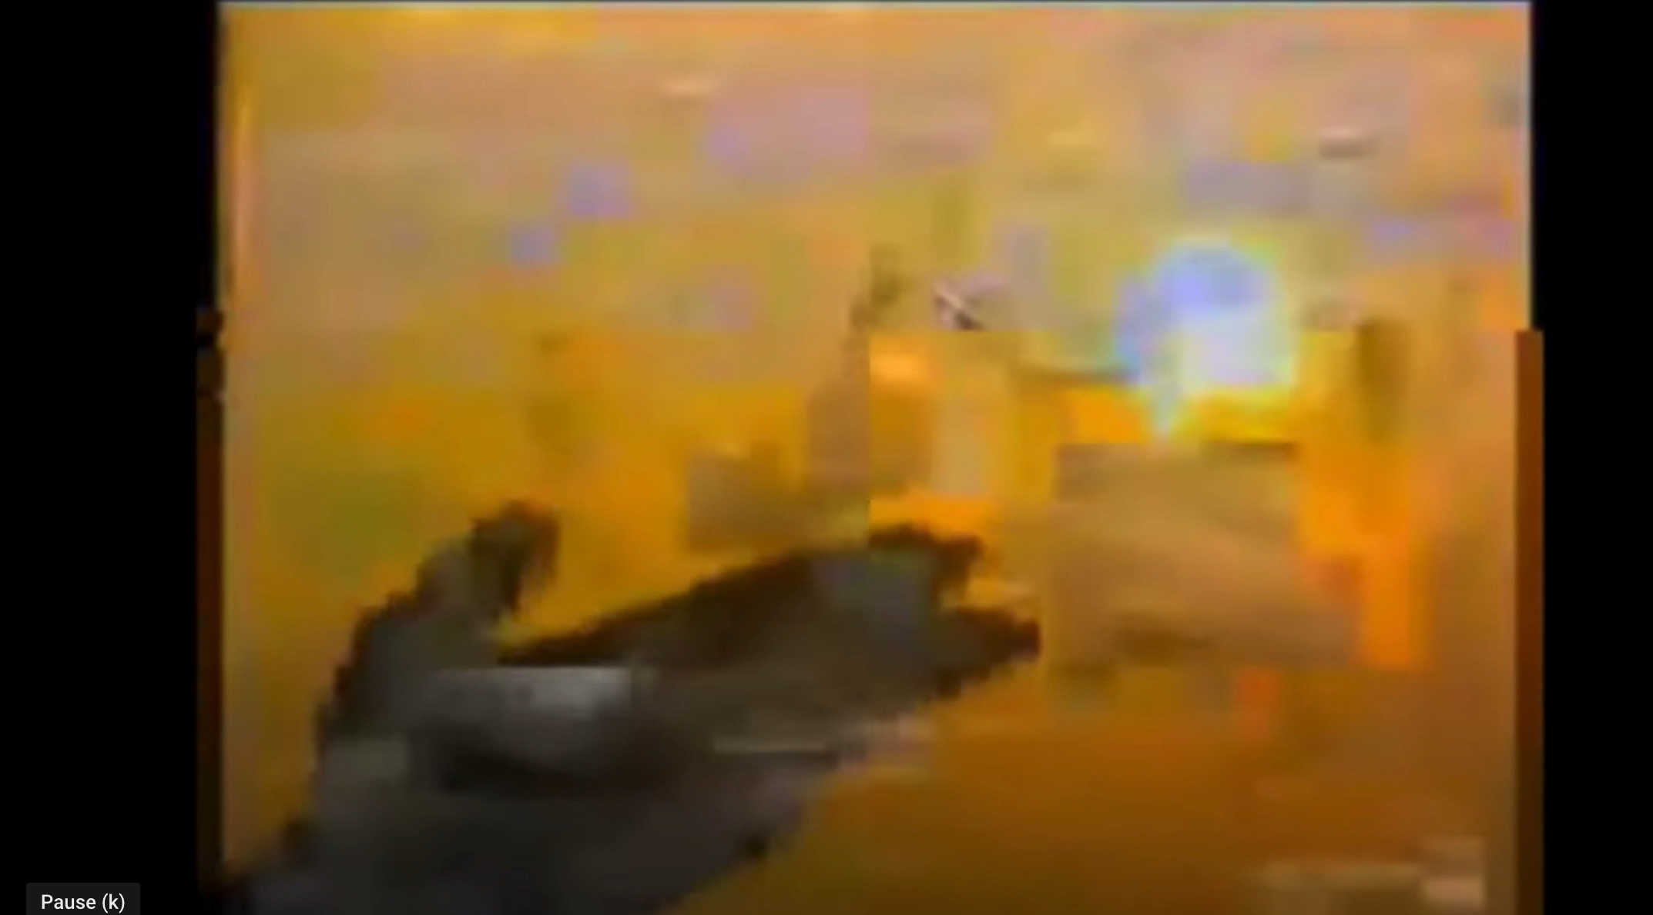

Slide 3
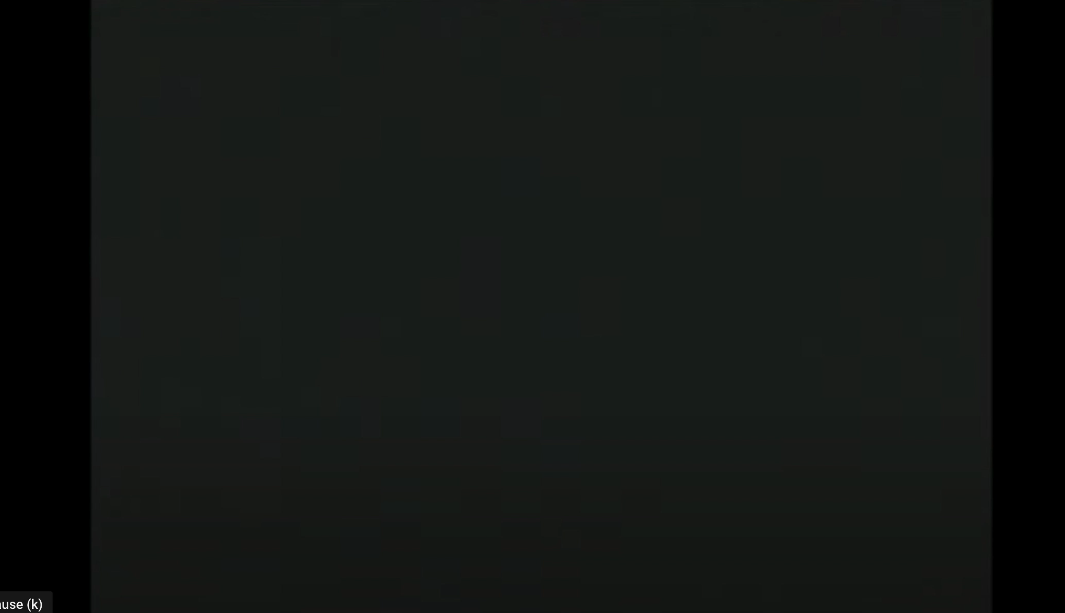
What is this Video trying to sell

Slide 4


Identify this vintage ad using the emoticons

Slide 5
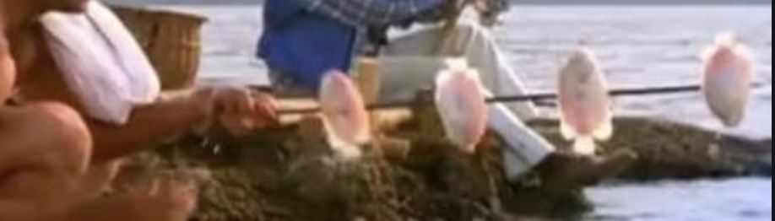
Identify this ad by a single frame

